Slide 1
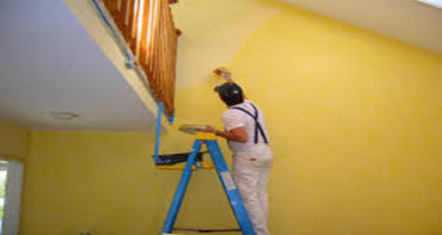
Safety Rules When Using Of Climbing a Ladder / Scaffolding.
1. Always avoid bringing a ladder/scaffolding into contact with electricity.
2. Place a ladder/ scaffolding so that its feet are a quarter of its length away the object it is
resting against.
3. The ladder/ scaffolding should be secured at the top.
4. Wherever possible, ladders/ scaffolding should be extended 1m above the support.
5. The ladder/ scaffolding should be inspected regularly and repaired when necessary.
6. As paint conceals, use vanish on wooden ladders or two coats of oil to preserve them.

Slide 2
7. Keep ladder/scaffolding clean because dirt hides defects while greases cause people to slip.
8. Do not leave ladder/ scaffolding lying on wet surfaces or exposed to the weather.
9. Do not use ladder/ scaffolding horizontal as runaways.
10. Tools and equipments should be hauled up by ropes not by ladder/ scaffolding.
11. Never leave a ladder/ scaffolding where it may fail.
12. Never place a ladder/ scaffolding in front of the door without taking adequate precautions.
13. Ladder/ scaffolding should be equipped with safety feet.
14. Use both hands when climbing up and down a ladder/ scaffolding.
15 Only one person at the time should use a ladder.
16. Store ladder/ scaffolding in a cool surface.
Demonstration Video :
-
Feedback : Activity

Slide 3
Kwa Thema Skills School
Subject : Maintenance Marks: 10
Grade : Year 2 Time : 30mins
Date :
Question : 1
1. State whether the following statements are true or false.
1.1 Use ladder/ scaffolding horizontal as runaways. _________
1.2 As paint conceals, use vanish on wooden ladders or two coats of oil to preserve them. ________
1.3 Wherever possible, ladders/ scaffolding should be extended 1m above the support. ________
1.4 The ladder/ scaffolding should be secured at the top. _________
1.5 Tools and equipments should be hauled by ladder/ scaffolding. _________
1.6 The ladder/ scaffolding should be inspected regularly and repaired when necessary. __________
1.7 Never leave a ladder/ scaffolding where it may fail. __________
1.8 Only one person at the time should use a ladder. ____________
1.9 Use both hands when climbing up and down a ladder/ scaffolding._________
1.10 Never place a ladder/ scaffolding in front of the door without taking adequate precautions. _________
(10)

